Slide 1
Retrieval Augmented Generation
(RAG)
Making AI Smarter with External Knowledge

Slide 2
Agenda
Introduction to RAG
  What is Retrieval-Augmented Generation?
  Why it matters
Types of RAG
  Web RAG
  Traditional RAG
RAG Workflow
  Document loading
  Text chunking
  Embedding creation
  Vector database setup
  Query and retrieval
  LLM generation
Key Components
  Document store
  Embedding model
  Vector database
  Large Language Model (LLM)
Benefits and Challenges
  Advantages of RAG
  Common pitfalls and solutions
Conclusion and Q&A

Slide 3
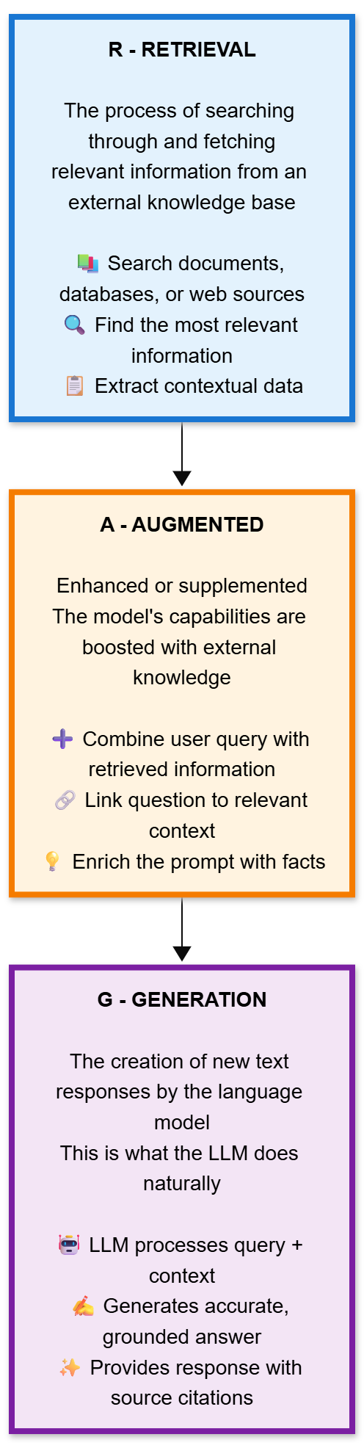
What is RAG?
Retrieval - The process of searching through and fetching relevant information from an external knowledge base, database, or document collection. Think of it like a search engine finding the most relevant documents based on a query.
Augmented - Enhanced or supplemented. The model's capabilities are being boosted by adding external information to what it already knows from training.
Generation - The creation of new text responses by the language model. This is what LLMs do naturally - they generate coherent text based on patterns learned during training.
RAG is a technique where, before generating a response, the system first retrieves relevant information from external sources, then uses that retrieved context to inform and improve its generated answer.

Slide 4
Types of RAG
Web RAG
Traditional RAG

Slide 5
Web RAG - Web Augmented Generation
RAG the retrieves from:
  Search engine results
  Public websites
  Real-time internet data
This is sometimes called "search-augmented generation" or similar terms, though it's still fundamentally the same RAG concept.
Internet search gives broader, current information but may return less focused results
Web RAG uses search engines not vector databases. Search engines themselves might use embeddings and vector similarity internally (modern search engines do), but that's completely abstracted away from you.

Slide 6
Traditional RAG
RAG the retrieves from:
  Private document collections
  Internal knowledge bases
  Curated databases
  Company-specific content
This is the most common use case because organizations want the LLM to answer questions based on their specific documents and data.
Private documents usually provide more controlled, relevant results for specific domains
Uses vector databases for semantic search

Slide 7
Why RAG matters
It lets models access up-to-date information beyond their training data
It provides a way to ground responses in specific, verifiable sources
It's particularly useful for domain-specific applications where you want the model to draw from a particular knowledge base
Instead of relying solely on what an LLM learned during training, a RAG system might first search your course materials, retrieve relevant sections about Java inheritance, and then generate an explanation that's grounded in those specific materials.

Slide 8
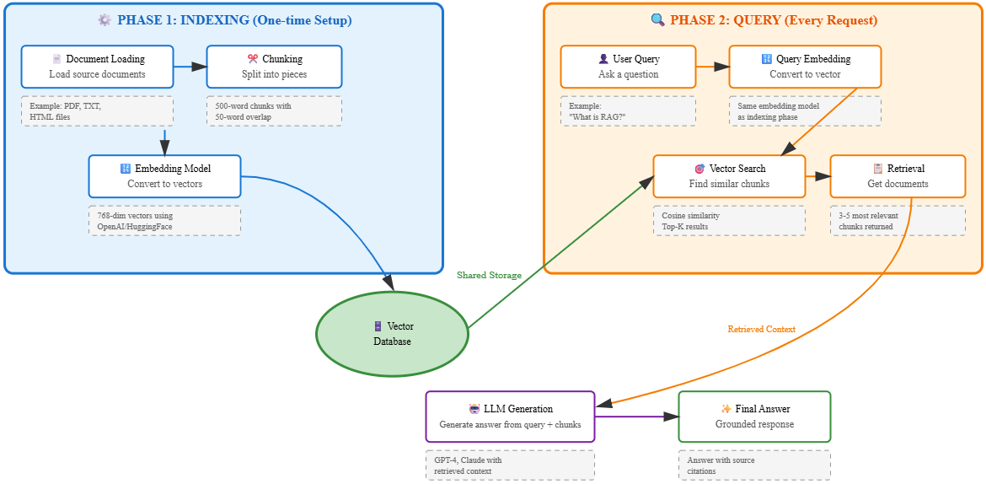
RAG Workflow

Slide 9
RAG Pipeline: Document Loading
First step in building a RAG system
Sources can include PDFs, Word documents, web pages, text files, databases
Data extraction tools convert various formats into plain text
Common libraries: PyPDF2, pdfplumber, BeautifulSoup, Docx2txt
May require preprocessing: removing headers/footers, cleaning formatting
Goal: Convert all source material into consistent text format for processing

Slide 10
RAG Pipeline: Text Chunking
Breaking documents into smaller, manageable pieces
Typical chunk size: 500-1000 tokens (roughly 300-700 words)
Overlap between chunks (50-200 tokens) prevents context loss at boundaries
Chunking strategies:
  Fixed-size chunking - Split by character/token count
  Sentence-based - Keep sentences intact
  Paragraph-based - Preserve document structure
  Semantic chunking - Split based on topic changes
Poor chunking can split important context and reduce retrieval quality

Slide 11
RAG Chunking with Overlap Example
Overlapping maintains context between chunks for better retrieval accuracy
Chunk # | Text Segment | Notes
Chunk 1 | “Artificial intelligence is transforming industries around the world. Machine learning enables systems to improve automatically through experience.” | Covers intro and ML definition.
Chunk 2 | “Machine learning enables systems to improve automatically through experience. Deep learning, a subset of machine learning, uses neural networks with many layers to analyze complex data.” | 30% overlap for context continuity.
Chunk 3 | “Deep learning, a subset of machine learning, uses neural networks with many layers to analyze complex data. These technologies are driving innovations in healthcare, finance, and education.” | Continues with same overlap pattern.

Slide 12
RAG Pipeline: Creating Embeddings
Converts text chunks into numerical vectors (embeddings)
Embeddings capture semantic meaning - similar concepts have similar vectors
Each chunk becomes a vector of typically 384-1536 dimensions
Popular embedding models:
  OpenAI text-embedding-3-small/large
  Sentence-Transformers (e.g., all-MiniLM-L6-v2)
  Google's text-embedding-gecko
  Cohere embed-english-v3.0
Important: Same model must be used for both documents and queries
Quality of embeddings directly impacts retrieval accuracy

Slide 13
Vector Embedding Example
Each vector is a list of numbers representing the phrase in semantic space — real embeddings usually have 768–1536 dimensions.
# | Phrase | Meaning
1 | “A cat sits on the mat.” | Simple sentence about a cat.
2 | “A kitten is lying on the rug.” | Very similar meaning — same topic (cat on surface).
3 | “The car engine is running fast.” | Completely different topic (mechanical).
Phrase | Example 8-D Embedding
1️⃣ A cat sits on the mat. | [0.11, 0.87, 0.64, 0.02, 0.93, 0.44, 0.55, 0.10]
2️⃣ A kitten is lying on the rug. | [0.14, 0.85, 0.67, 0.03, 0.91, 0.46, 0.58, 0.12]
3️⃣ The car engine is running fast. | [0.90, 0.12, 0.33, 0.88, 0.15, 0.72, 0.11, 0.95]

Slide 14
Vector Embedding Example Continued
Phrases 1 and 2 have similar vector patterns (high in positions 2 & 5 → “animal/resting” semantics).
Phrase 3 is very different — high values in completely different dimensions (mechanical / motion).
In a semantic vector space,
  cosine similarity(1,2) ≈ 0.96 (very close)
  cosine similarity(1,3) ≈ 0.20 (distant)

Slide 15
RAG Pipeline: Vector Database
Specialized database optimized for storing and searching embeddings
Enables fast similarity search across millions of vectors
Stores both the embedding vector and the original text chunk
Popular vector databases:
  Pinecone - Managed cloud service
  Weaviate - Open source with cloud option
  ChromaDB - Lightweight, easy to use
  Qdrant - High-performance open source
  FAISS - Facebook's similarity search library
Uses algorithms like HNSW, IVF for efficient approximate nearest neighbor search

Slide 16
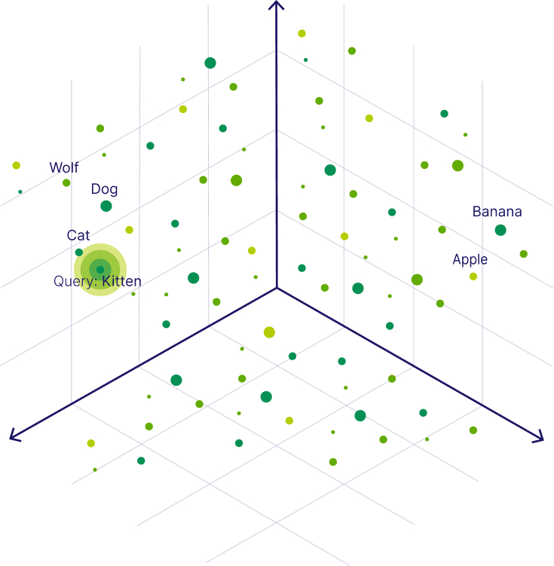
Vector Database Visualized

Slide 17
RAG Pipeline (Phase 2): Query Embedding
User's question is converted into an embedding vector
Must use the same embedding model as the document chunks
Query embedding is typically much shorter than document chunks
The vector representation allows semantic matching, not just keyword matching
Example: Query 'how to loop in programming' matches chunks about 'for loops' and 'iteration'
Query preprocessing may help: removing stop words, expanding abbreviations
This step happens in real-time for each user query

Slide 18
RAG Pipeline: Vector Search and Retrieval
Vector database finds chunks most similar to the query embedding
Similarity measured using cosine similarity or euclidean distance
Typically retrieve top 3-5 most relevant chunks (configurable)
Returns both the text chunks and their similarity scores
Can apply filters: date ranges, document types, metadata
May use re-ranking models to improve relevance of top results
Trade-off between number of chunks and context window size
Retrieved chunks provide the 'grounding' context for the LLM

Slide 19
RAG Pipeline: LLM Generation
Final step: LLM generates answer using query + retrieved context
Prompt structure typically includes:
  System instructions (role, behavior guidelines)
  Retrieved document chunks (the 'context')
  User's original question
  Instructions to cite sources or stay within context
LLM synthesizes information from multiple chunks into coherent answer
Can include source citations by referencing specific chunks
If context doesn't contain answer, LLM should acknowledge this
Quality depends on both retrieval accuracy and LLM capabilities

Slide 20
RAG Process Step-by-Step
Phase 1: Indexing (One-time setup)
  Load documents and split into chunks (e.g., 500-word segments with overlap)
  Convert chunks to embeddings using an embedding model
  Store embeddings in a vector database
Phase 2: Query (Every request)
  User asks a question
  Convert question to embedding using the same model
  Search vector database for similar chunks (semantic search)
  Retrieve top 3-5 most relevant chunks
  LLM generates answer combining query + retrieved chunks

Slide 21
Key Components of RAG
Document Store / Knowledge Base
  Collection of documents, PDFs, web pages, or structured data that serves as the source of information
Embedding Model
  Converts text into numerical vectors (embeddings) that capture semantic meaning
Vector Database
  Stores and indexes embeddings for fast similarity search (e.g., Pinecone, Weaviate, ChromaDB)
Large Language Model (LLM)
  The AI model that generates the final response using both the user query and retrieved context

Slide 22
Benefits of RAG
Benefits
  Up-to-date information without retraining the model
  Reduces hallucinations by grounding responses in real documents
  Provides source citations for transparency
  Cost-effective compared to fine-tuning large models

Slide 23
Drawbacks of RAG
Retrieval quality bottleneck - System performance is limited by the quality of the retrieval mechanism
Context window limitations - Retrieved documents must fit within the model's context window
Increased complexity - Requires managing additional infrastructure (vector databases, embedding models)
Higher latency - Retrieval step adds processing time to each query
Relevance drift - Retrieved documents may not always be relevant to the specific query
Maintenance overhead - Knowledge base must be kept current and accurate
Cost considerations - Storage and compute costs for embeddings and vector search
Chunking challenges - Poor chunking can split important context across boundaries

Slide 24
TikTok – mlgonzo1
Understanding RAG Pipelines in AI Development | TikTok

Slide 25
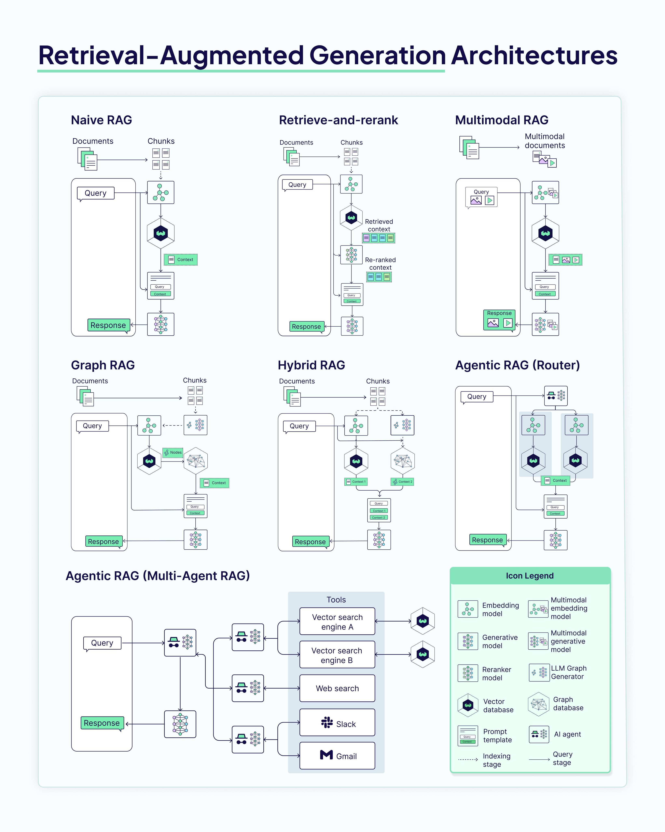
The Future of RAG
Current State of RAG
Moving from "proof of concept" to sophisticated implementations
RAG combines retrieval systems with generative AI models
Enhances AI responses with external, up-to-date knowledge
Critical for reducing hallucinations and improving accuracy

Slide 26
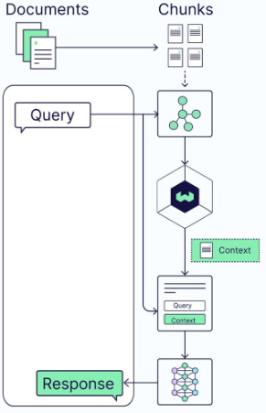
Naive RAG The Basic Approach
How it works:
You ask a question
System searches documents and finds relevant chunks
AI reads the information and generates an answer
Simple analogy: Asking a librarian to find books on a topic, then reading those books to answer your question
Characteristics: Straightforward and simple - the foundation of all RAG systems

Slide 27
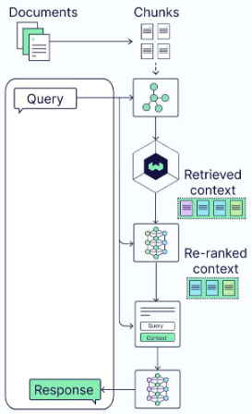
Retrieve-and-Rerank Adding Quality Control
How it works:
Retrieves relevant information like Naive RAG
Adds an extra step: re-evaluates and ranks results by quality
Only the most relevant information goes to the AI
Simple analogy: A librarian who not only finds books, but skims them and hands you only the most relevant pages in order of importance
Key improvement: Better information quality through ranking

Slide 28
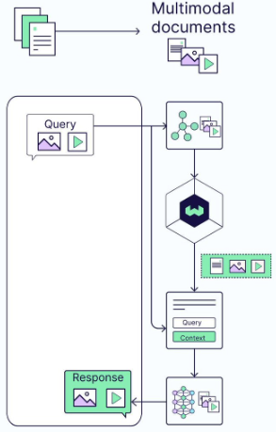
Multimodal RAG Beyond Text
How it works:
Handles multiple content types: text, images, videos, audio
Can accept queries with mixed media
Retrieves and processes different formats together
Simple analogy: A librarian who helps with books, photographs, videos, and audio recordings all at once
Key capability: Works with any type of content, not just text

Slide 29
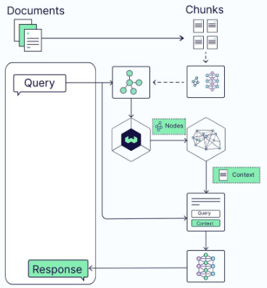
Graph RAG Understanding Relationships
How it works:
Maps connections between pieces of information
Understands how concepts relate to each other
Retrieves information based on relationships, not just similarity
Simple analogy: A mind map or family tree showing how different pieces of knowledge connect, not just isolated facts
Key advantage: Captures context through relationships and dependencies

Slide 30
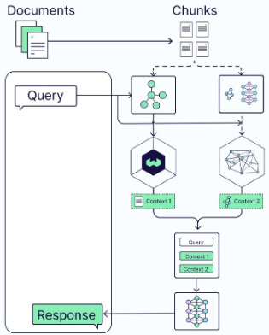
Hybrid RAG Combining Multiple Approaches
How it works:
Uses multiple retrieval strategies simultaneously
Might combine similarity search with relationship understanding
Flexible - uses whichever method works best for the question
Simple analogy: Having both a traditional library catalog AND a librarian who knows how topics connect
Key strength: Adaptability through multiple methods

Slide 31
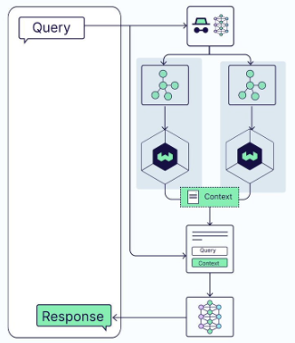
Agentic RAG (Router) Intelligent Routing
How it works:
Analyzes the question first
Decides which retrieval method is most appropriate
Routes the query to the best strategy
Simple analogy: A reference desk that directs you to different library departments based on what you're looking for
Key feature: Smart decision-making about retrieval approach

Slide 32
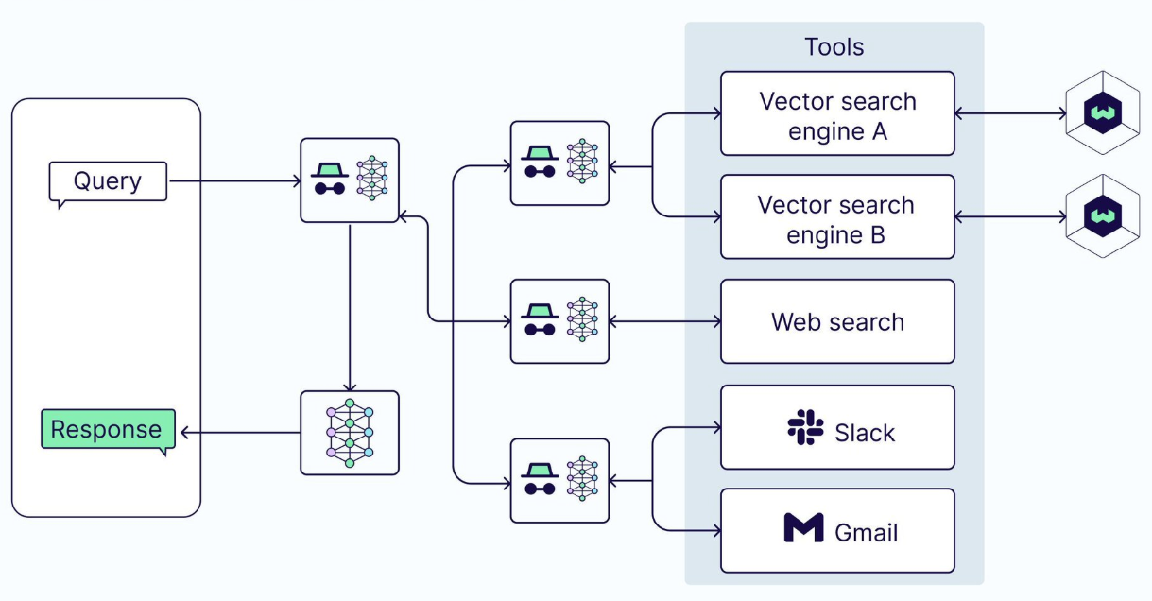
Agentic RAG (Multi-Agent) Coordinated Specialists
How it works:
Multiple AI agents with different capabilities work together
Each agent uses different tools: vector search, web search, email, Slack
Agents coordinate to gather comprehensive information
Simple analogy: A research team where different people check different sources and share their findings
Key capability: Most sophisticated - multiple specialists collaborating

Slide 33
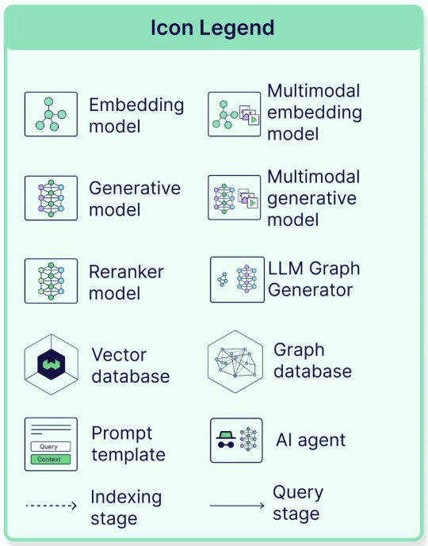

Slide 34
Evolution of RAG Architectures
Progression of complexity:
Naive: Simple and straightforward
Retrieve-and-rerank: Adds quality control
Multimodal: Handles different content types
Graph: Understands relationships
Hybrid: Combines multiple approaches
Agentic Router: Makes smart decisions
Multi-Agent: Multiple specialists working together
Trade-off: Simplicity vs. sophisticated retrieval capabilities

